Slide 1
DeepRacer
4109053049 張康磊
4110053037 王盈穎
4110053048 陳冠妤

Slide 2
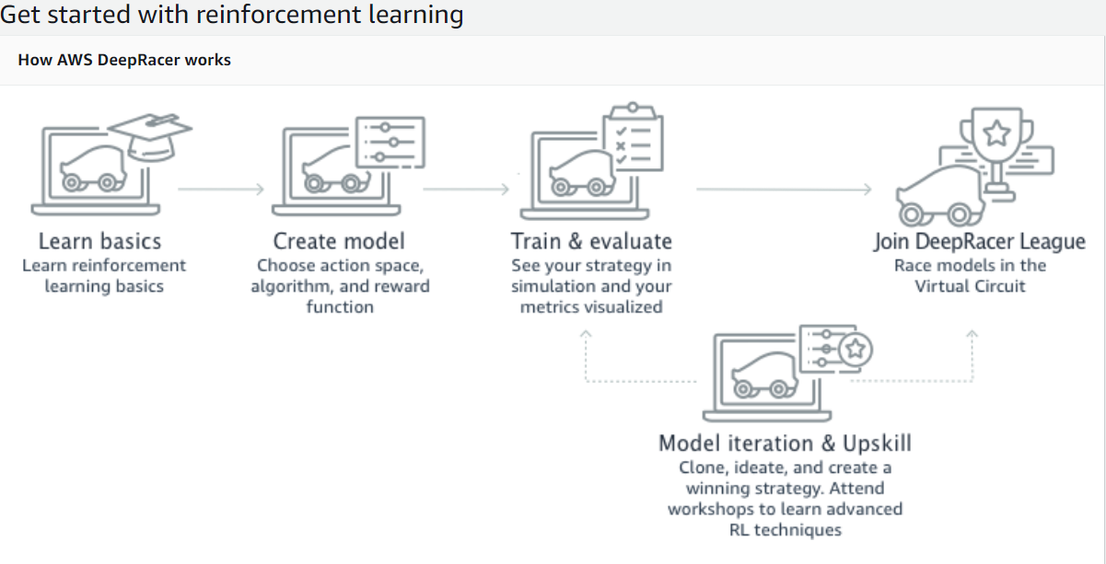

Slide 3
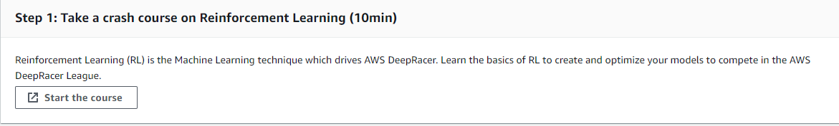

Slide 4
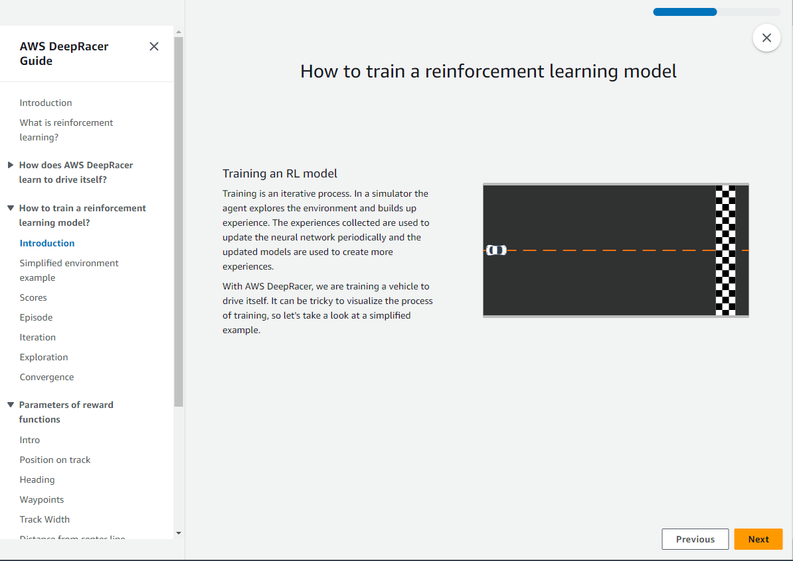

Slide 5
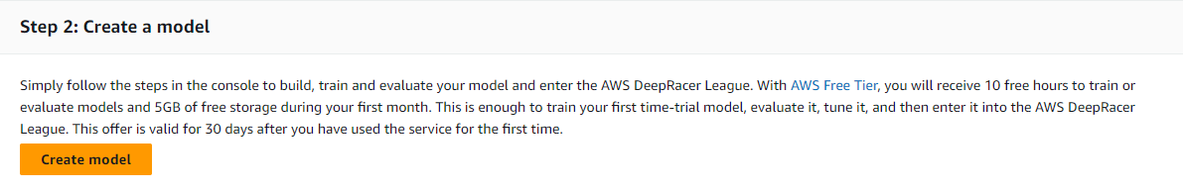

Slide 6
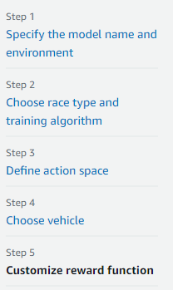

Slide 7
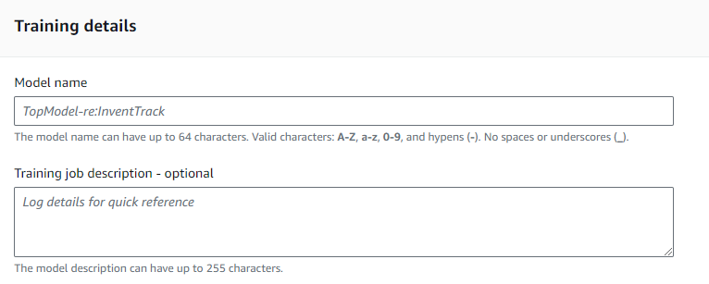
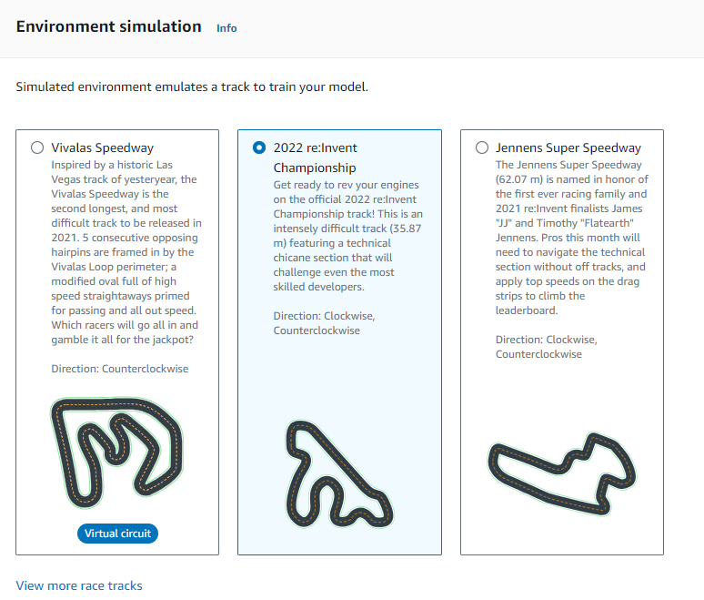
STEP1:

Slide 8
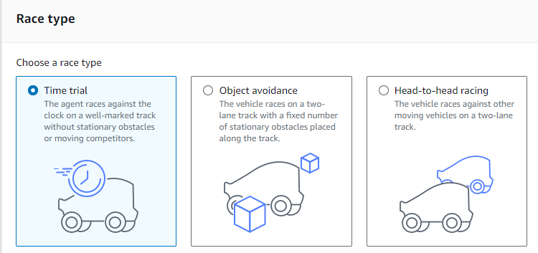
STEP2:

Slide 9
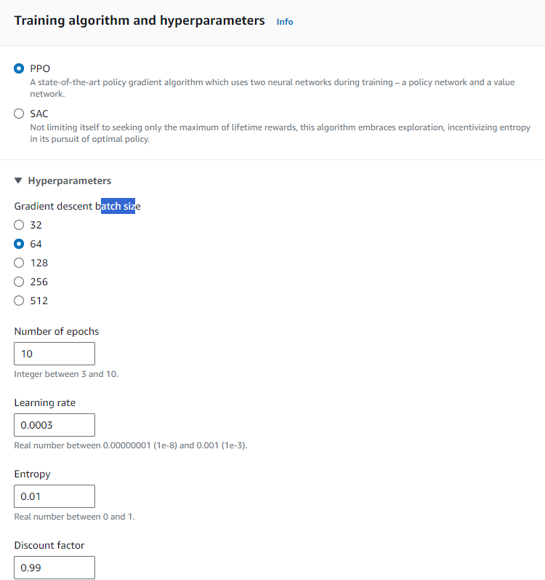

Slide 10
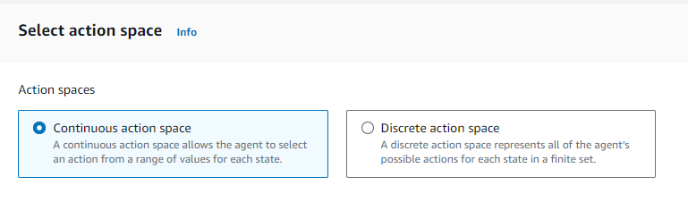
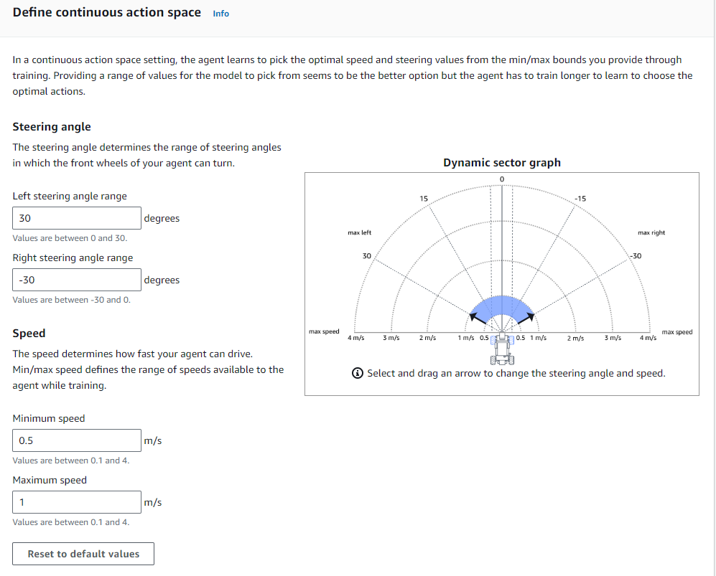
STEP3:

Slide 11
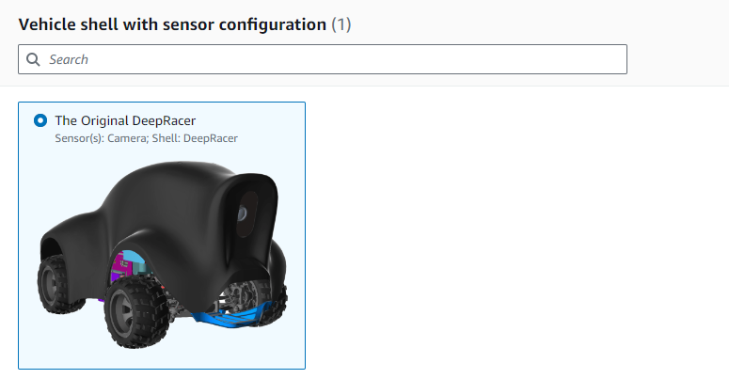
STEP4:

Slide 12
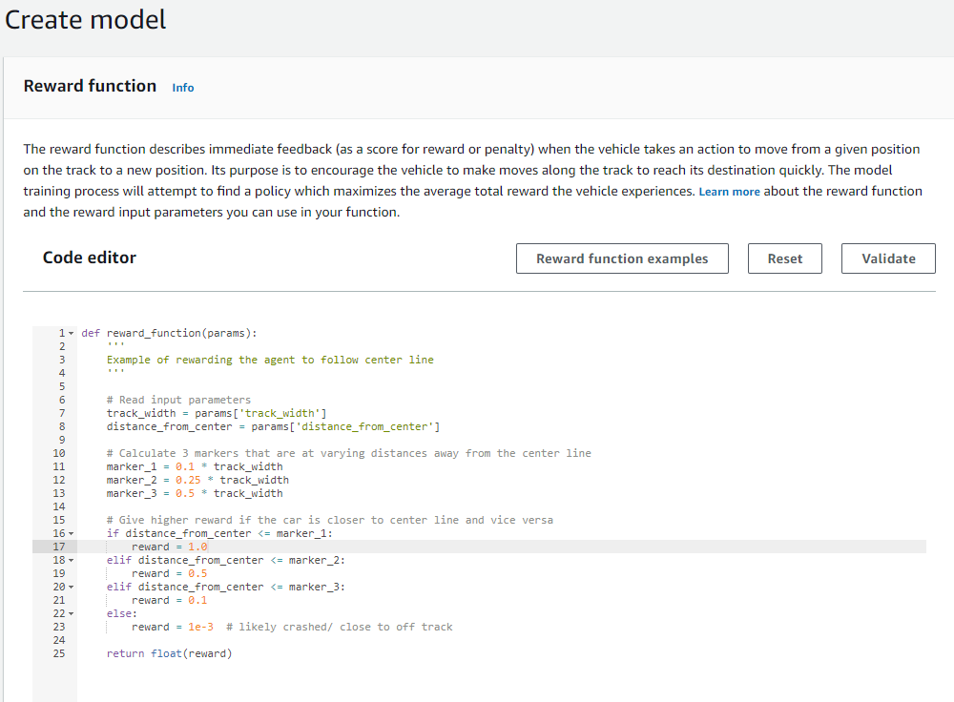
STEP5:

Slide 13
參考網址:
https://engineering.linecorp.com/zh-hant/blog/aws-deepracer-2019
https://us-east-1.console.aws.amazon.com/deepracer/home?region=us-east-1#createModel

